Slide 1
Developing a Personal Rule of Life

Slide 2
Welcome and Opening Prayer

Slide 3
An invitation…
“Are you tired? Worn out? Burned out on religion? Come to me. Get away with me and you’ll recover your life. I’ll show you how to take a real rest. Walk with me and work with me - watch how I do it. Learn the unforced rhythms of grace. I won’t lay anything heavy or ill-fitting on you. Keep company with me and you’ll learn to live freely and lightly.”
Matthew 11:28-30 (MSG)

Slide 4
‘Rule’ and ‘rules’...
I’ve always found it difficult to follow rules - I don’t like the thought of being told what to do. Sounds a bit legalistic to me.
I think some rules and routines can be helpful. I have certain boundaries in my life that help me to stay focused.
Will
The thought of breaking rules makes me feel anxious. Won’t a Rule of Life just make me feel guilty if I struggle to keep to it?
David
Sara

Slide 5
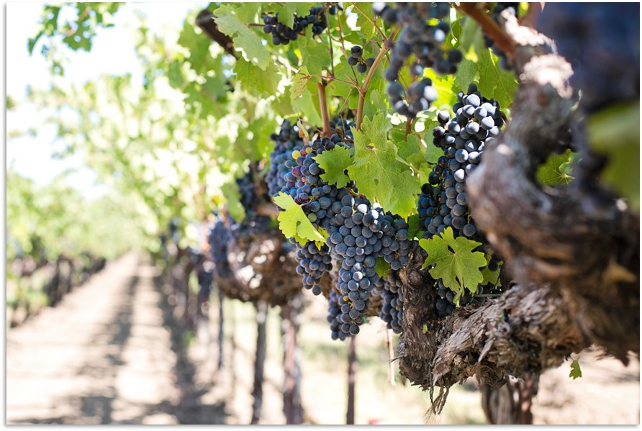
Regula => Rule

Slide 6
A Personal Rule of Life
is not…
one size fits all
a set of rules
adhered to out of fear
is...
developed by you
appropriate for your life and context
flexible
habits, routines and practices that help you to become more Christ-like
a response to God’s love

Slide 7
Habit Reflection Task
Which of your current habits do you find helpful?
Which do you find unhelpful?

Slide 8
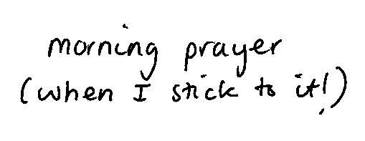
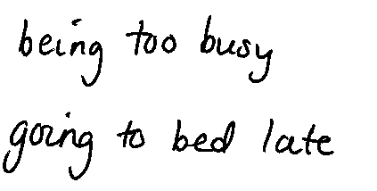
My example:

Slide 9
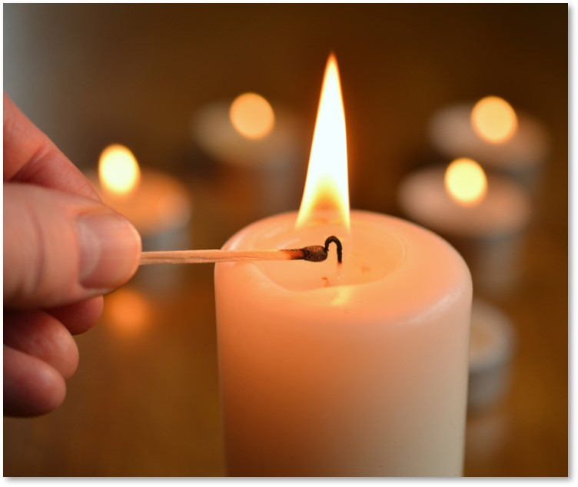
Being Lights for Christ
Every follower of Jesus shares in being ‘the light of the world’ (Matthew 5:14).
How can we put this idea into practice?
Receiving Christ’s light as his friends;
Walking in Christ’s light as his followers;
Reflecting Christ’s light to those around us.

Slide 10
Receiving – being with Jesus Walking – becoming more like Jesus Reflecting – sharing Jesus with others

Slide 11
Time for a break!

Slide 12
Receiving Christ’s Light
Praying and seeking God’s will
Participating in the life and worship of the Church
Reading and reflecting on the Scriptures
Receiving Communion
Opening our lives to the Holy Spirit

Slide 13
Walking in Christ’s Light
Enjoying God’s gifts with gratitude
Living by the teaching of Jesus
Giving generously to others
Giving and receiving forgiveness
Balancing work and rest

Slide 14
Reflecting Christ’s Light to Others
Loving and praying for those we live and work with
Sharing Jesus in our communities
Serving those in need
Challenging injustice and promoting peace
Caring for God’s Creation

Slide 15
Encouraging Each Other

Slide 16
Join our online community!
www.facebook.com/groups/personalruleoflife

Slide 17
Commitment Prayer
Lord Jesus Christ,
you are the light of the world, the light of life.
I pray that, as I make these commitments,
I will be drawn ever closer to you and receive your light,
so that, as I walk with you I will follow your light,
and reflect your light to all around me,
to the honour of your Name.
Amen.

Slide 18
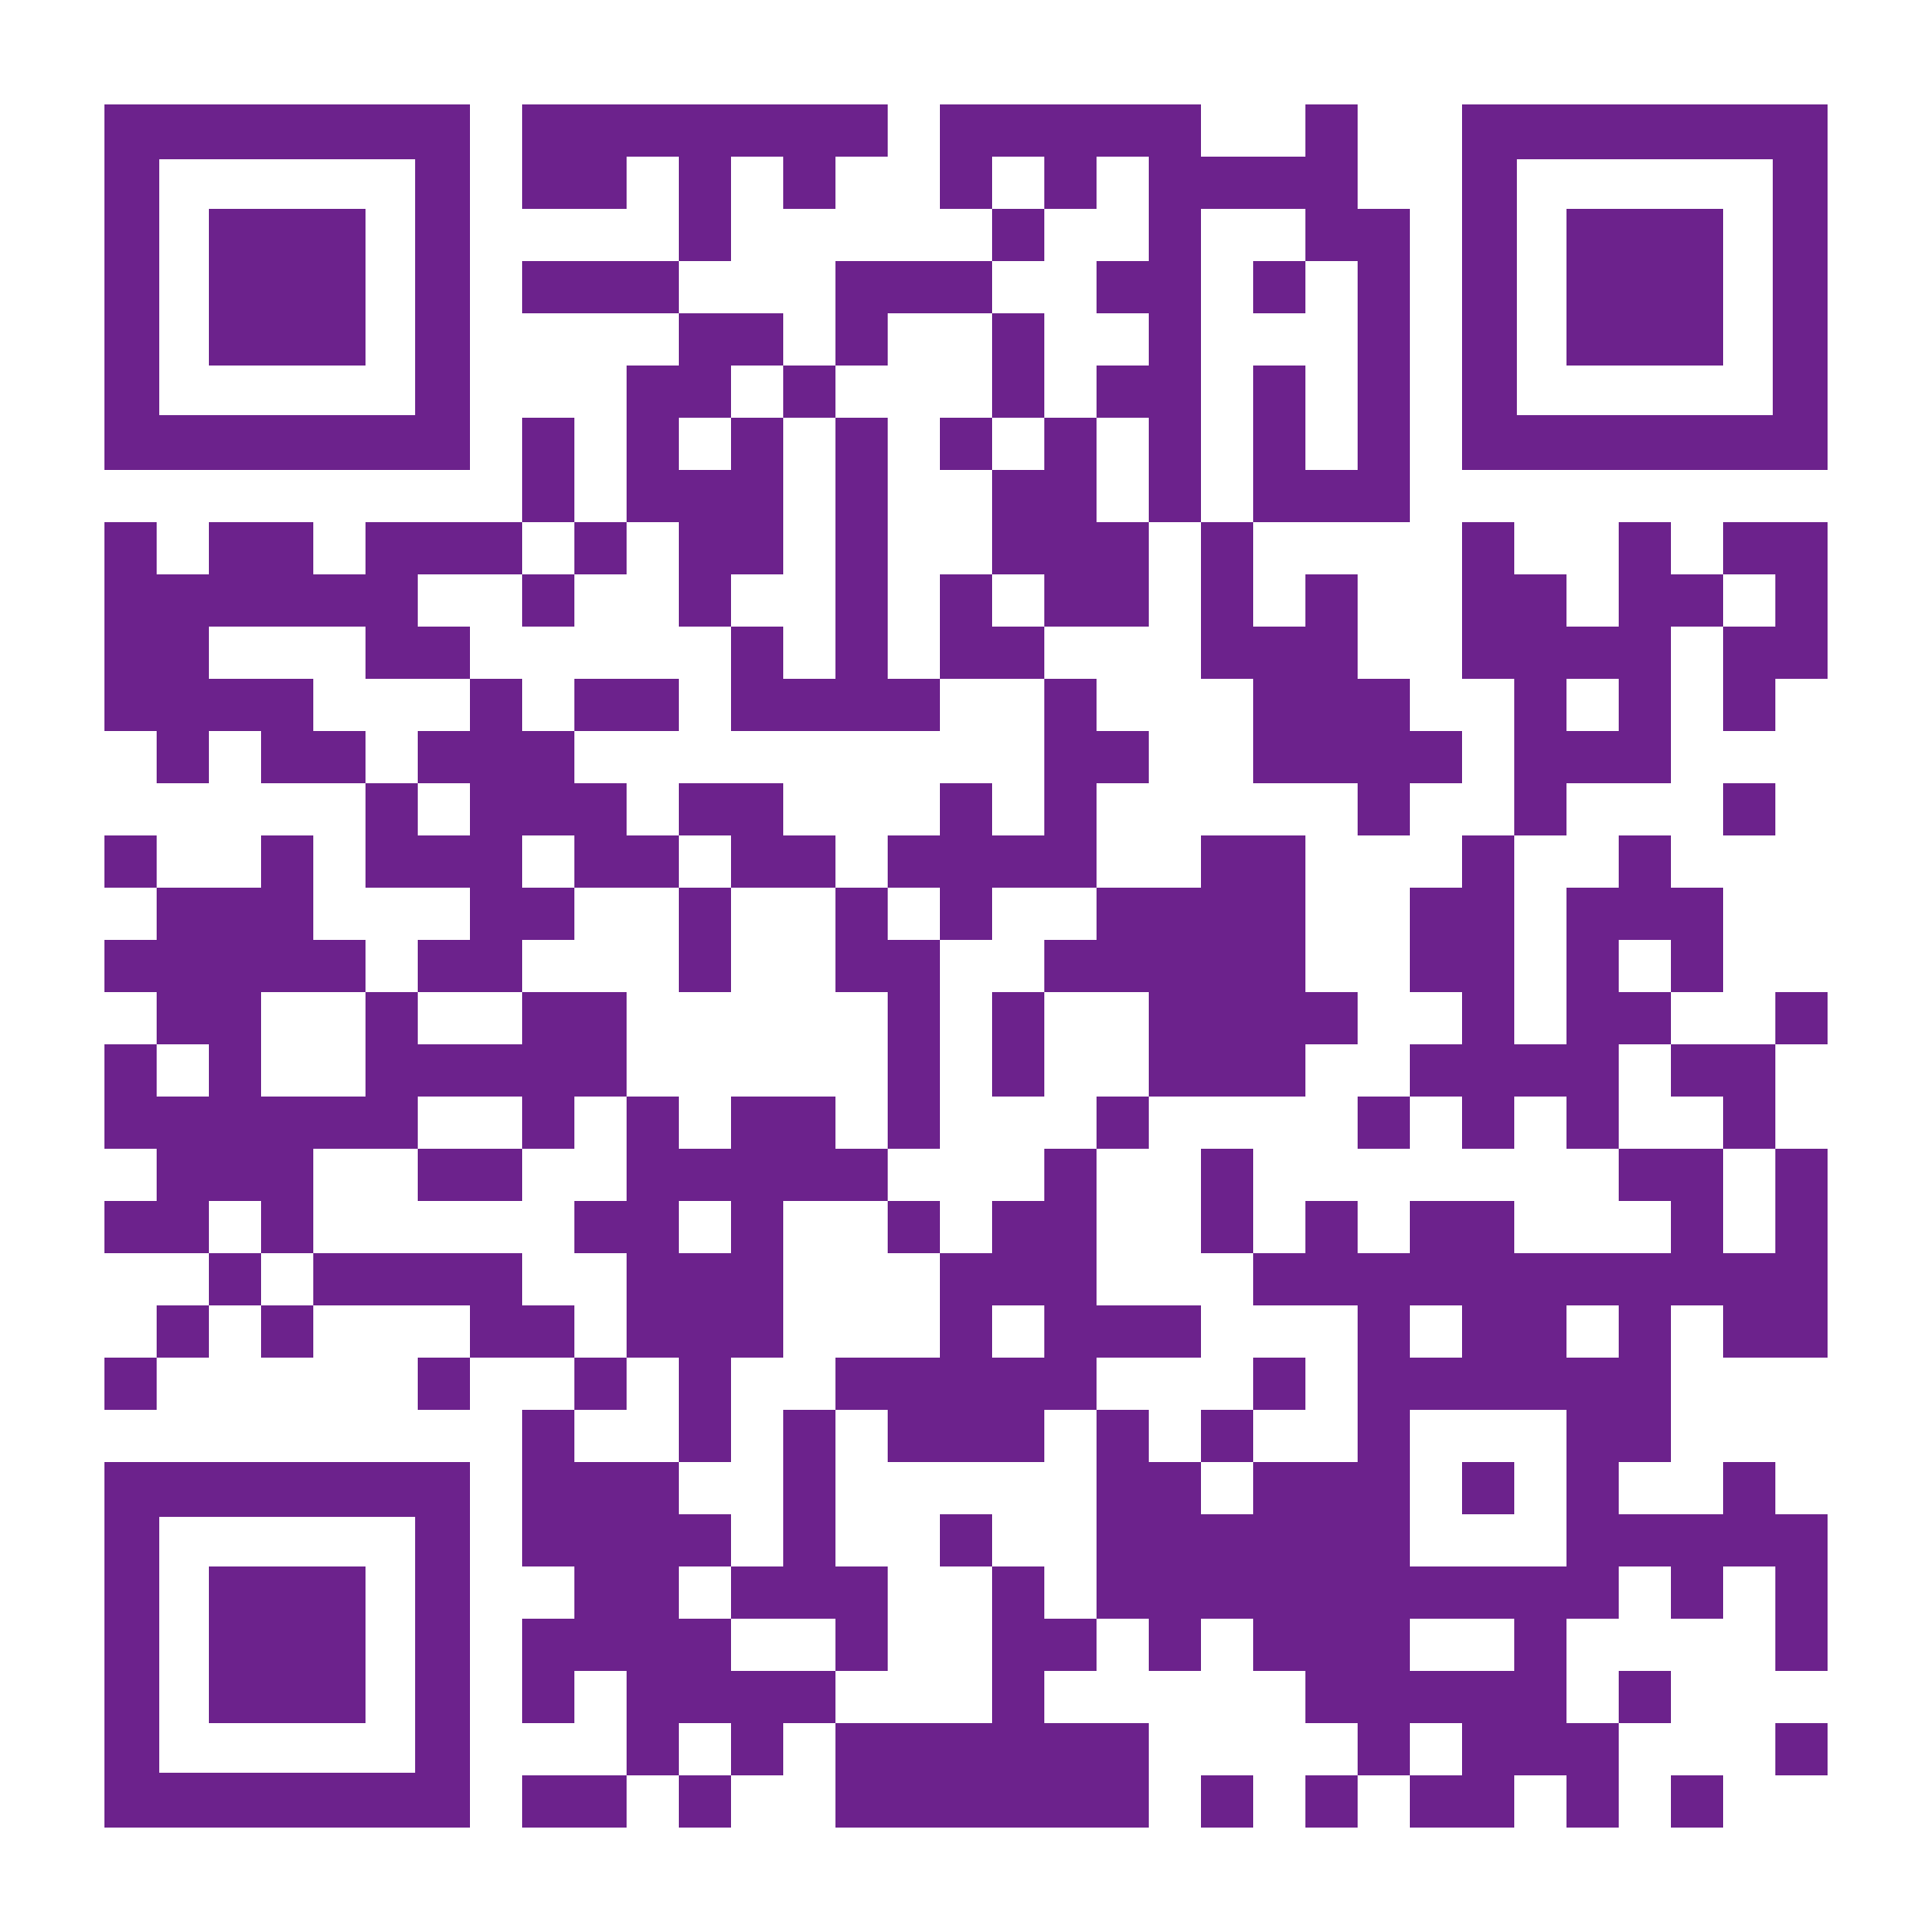
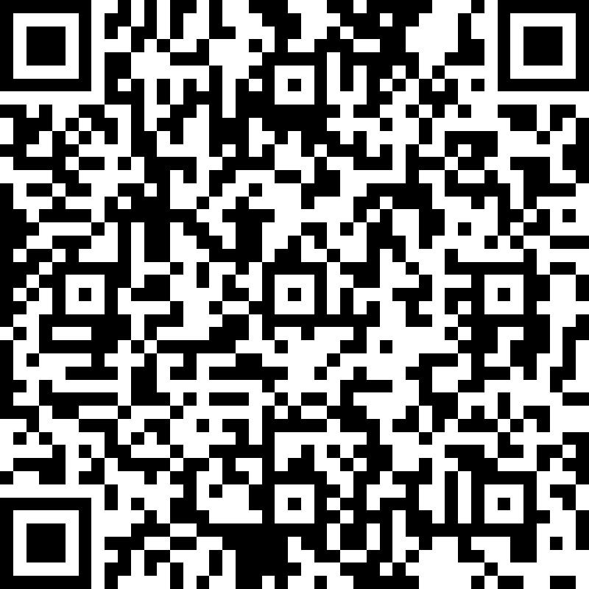
Leave us some feedback:
Join our online community!
Short online survey:
https://forms.office.com/r/R8AC4Zt1s3
www.facebook.com/ groups/personalruleoflife

